Slide 1
Retaining Water Ice in Regolith at Vacuum - T519
Design Review 5
March 7, 2024

Slide 2
Team Introductions
Trent Walker
Kevin Hernandez Lichtl
Astronautical Engineer
Luke Leibkuchler
Systems Engineer
Katherine Mesa
Fluid Test Engineer
Megan Reid
Design Engineer
Trent Walker
Thermal Fluids Engineer

Slide 3
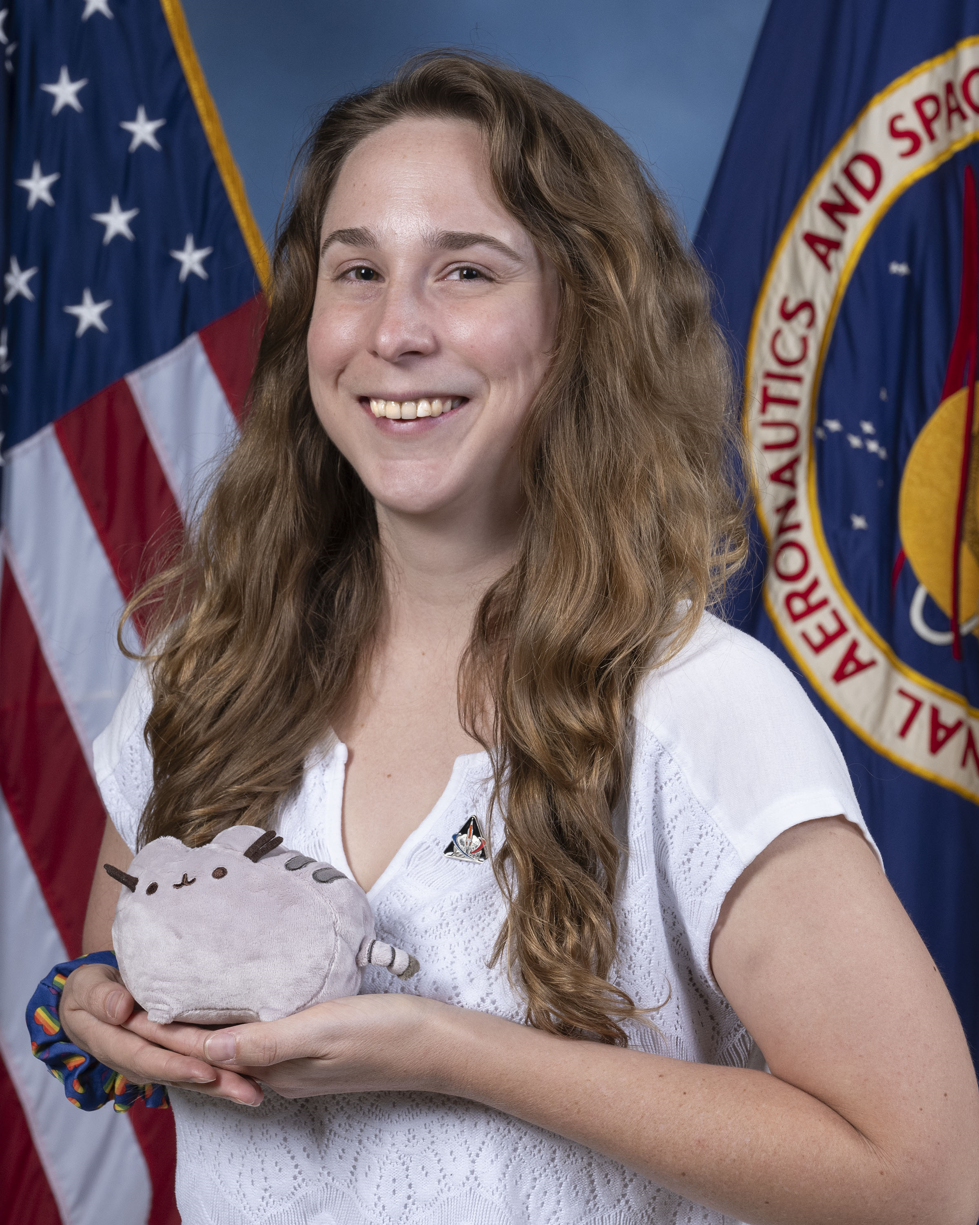
Sponsor and Advisor
Trent Walker
Annette Gray
NASA-Marshall Space Flight Center
Mentor
Marvin Barnes
NASA-Marshall Space Flight Center
Sponsor
Dr. Shayne McConomy
FAMU-FSU College of Engineering
Advisor

Slide 4
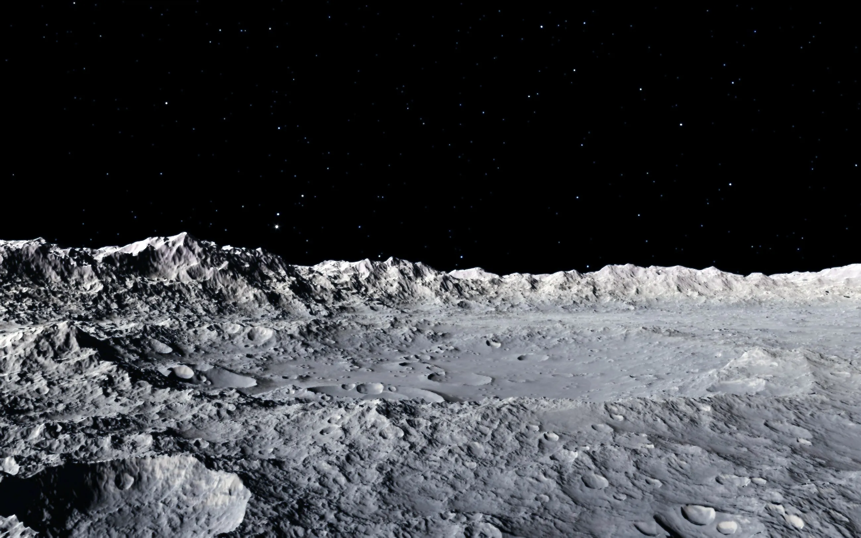
Objective
Trent Walker
The objective of this project is to mimic the lunar surface environment in a test fixture​
Notes:
“In order to mimic the lunar surface, we need to understand it first”

Slide 5
Lunar Surface
Trent Walker
Water is found as ice in shadowed regions on craters
Atmospheric pressure is equivalent to 2.96x10⁻¹⁵ atm
Surface is made of regolith
Average temperature ranges from
-183°C to 107°C (90 K to 380 K)
Notes:
To verify performance of structures, mechanisms, and processes, NASA created the PLANET Chamber in Huntsville.
Our job is to simulate lunar surface conditions with a regolith simulant (material that has similar chemical comp. to regolith)

Slide 6
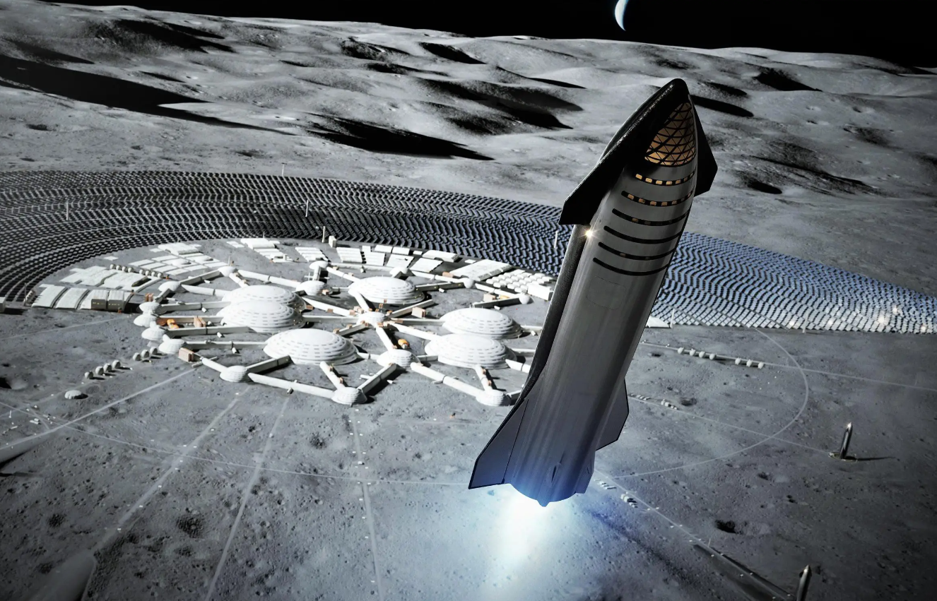
Background
Trent Walker
Water ice in craters on the poles
Develop technologies to extract ice
Convert ice into fuel
Lunar Station
Notes:
As we move towards being an interplanetary species
To allow for human travel throughout the solar system, it is believed a lunar colony will be a necessity.
Rather than embarking from Earth, a lunar station will significantly more energy efficient as the moon has a much weaker gravitational force to overcome.
It is believed the moon has water ice hidden in permanently shadowed areas of craters.
Convert H2O --> H2 + O

Slide 7
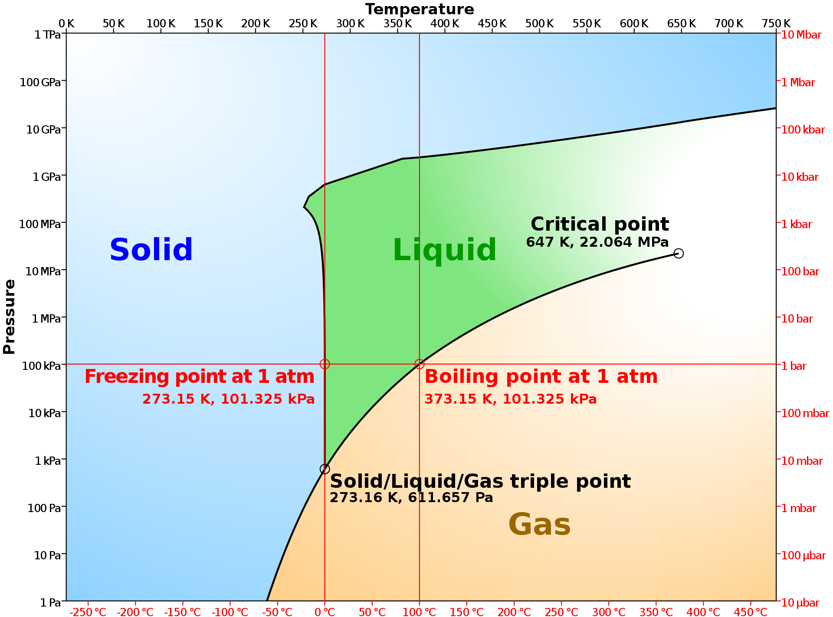
Properties of Water
Trent Walker
Notes:
Water Phase Diagram
Lots of energy when saying going down to this pressure without sublimating – main reason we are here

Slide 8
Targets and Metrics
Trent Walker
Water Composition
Prepare a testing sample containing 4-10% water in the regolith-water mixture
Cryogenic Temperatures
Cool sample down to 170K to 200K (-103°C to -73°C )
High Vacuum Pressure
Testing fixture can withstand pressures from 1 atm - 10⁻¹⁰ atm (${10}^{−6} to {10}^{−7}torr)$

Slide 9
Initial Design
Trent Walker
How it Works
Liquid Nitrogen Drip
Flow LN2
LN2 Drips
Regolith
Sample is cooled
Notes:
How do we ensure temperature is maintained?

Slide 10
Initial Design
Trent Walker
Liquid Nitrogen Drip
Main Limitation
Since the Drip Lid must be removed, No Cooling during:
Experimental setup
Pump down
Extraction test in high-vacuum
Notes:
How do we ensure temperature is maintained?

Slide 11
Previous Design Changes
Trent Walker
Liquid Nitrogen Drip
Cryogenic Jacket
Maximize Cooling
Maintain Temperature
Notes:
“to target the limitations found with the nitrogen drip, we decided to combine our top two ideas into one: the nitrogen drip and the cryogenic temperature”

Slide 12
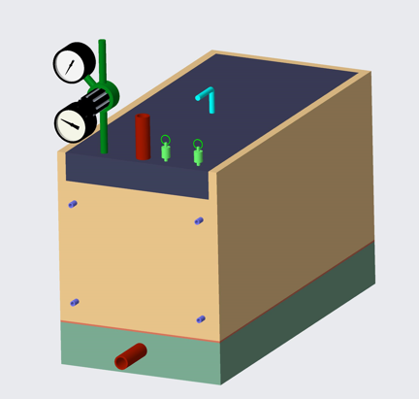
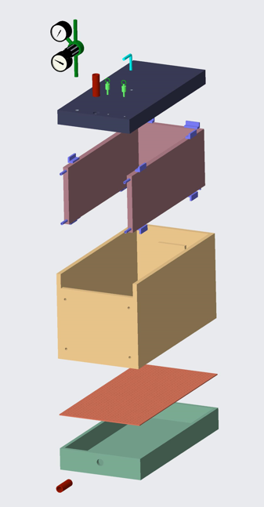
Previous Design
Trent Walker
Lid
Jacket
Shell
Grate
Bottom

Slide 13
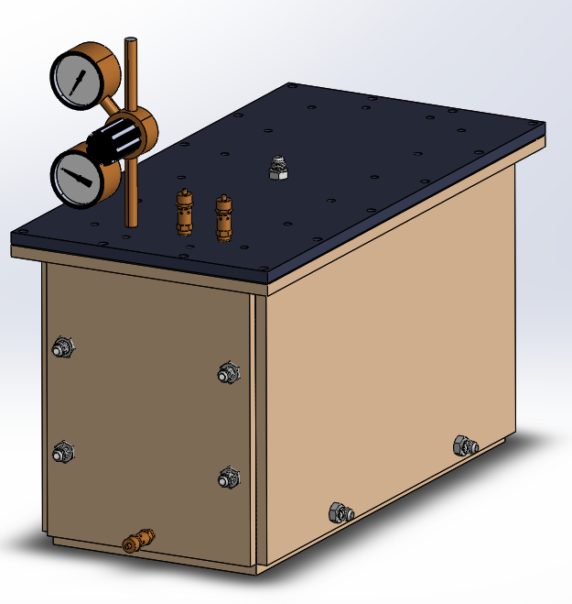
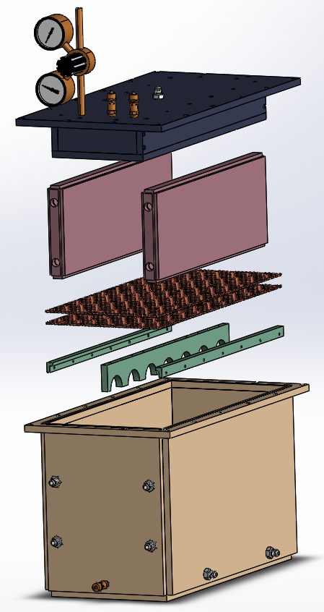
Final Design
Trent Walker
Lid
Sleeves
Grate
Mounts
Bed

Slide 14
Final Design
Trent Walker
3/8"
3/8"
1/2"

Slide 15
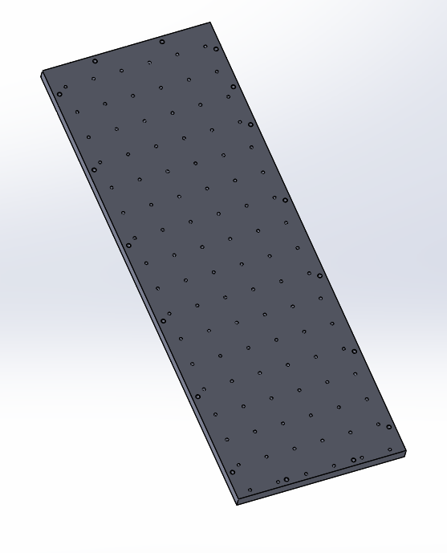
Final Design
Trent Walker
#10-24 Tapped
Array of Holes for Liquid Nitrogen

Slide 16
New Design Changes
Kevin Hernandez-Lichtl
1
Condensed and Simplified
2
Machinability
3
Flow and Pressure Concerns

Slide 17
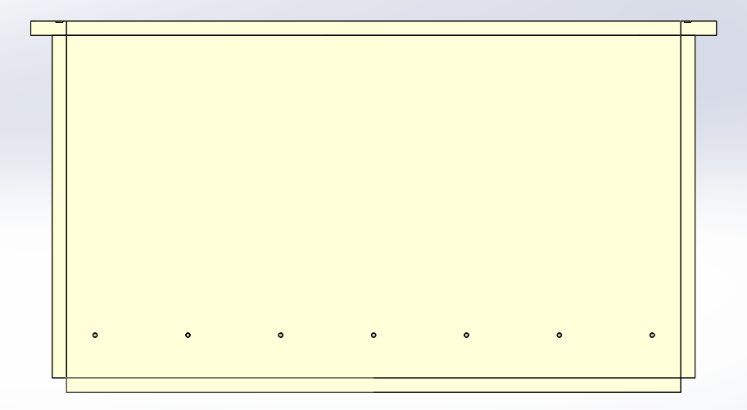
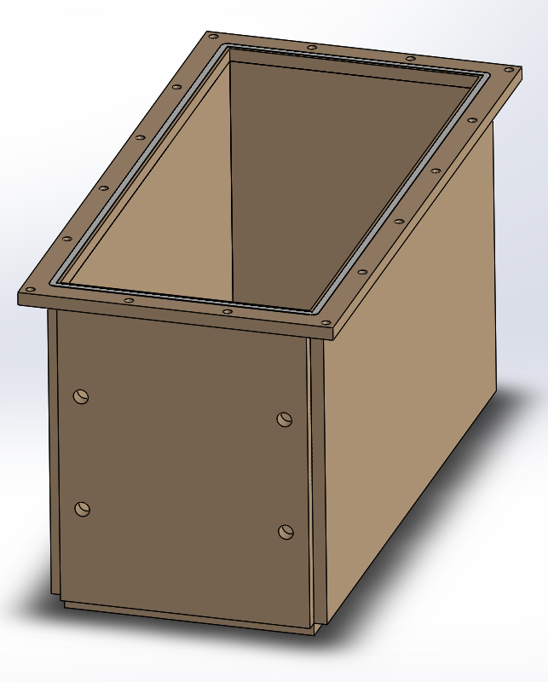
Regolith Bed
Kevin Hernandez-Lichtl
Section View
Flange
Exploded View
Teflon Gasket
Welded corners and edges

Slide 18
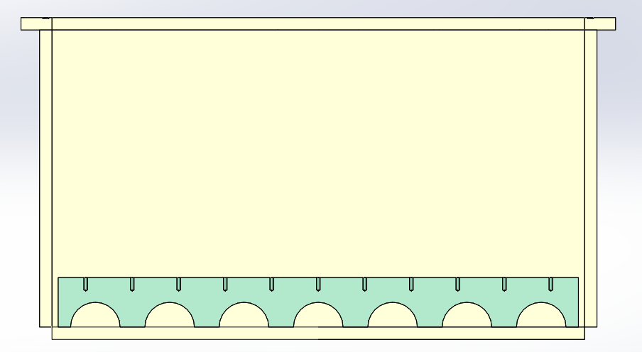
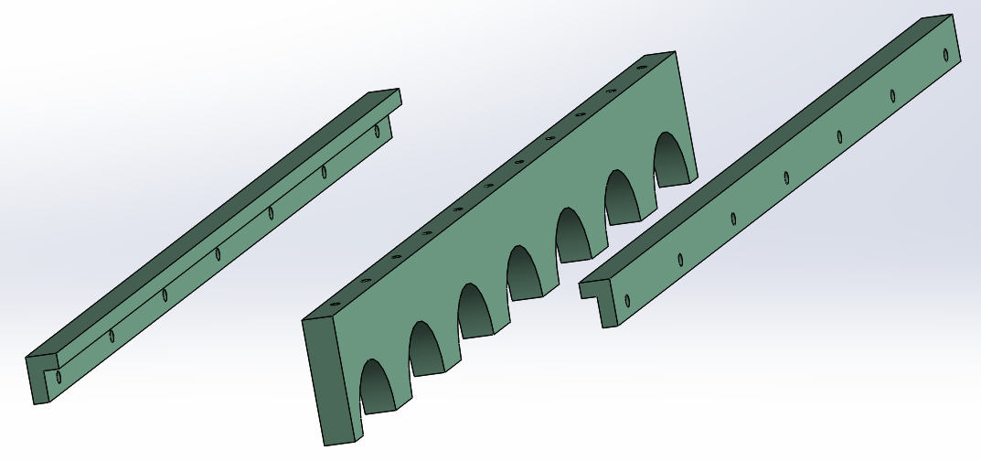
Grate Mounts
Kevin Hernandez-Lichtl
Ledge for Grate
Gaps to allow for gas flow

Slide 19
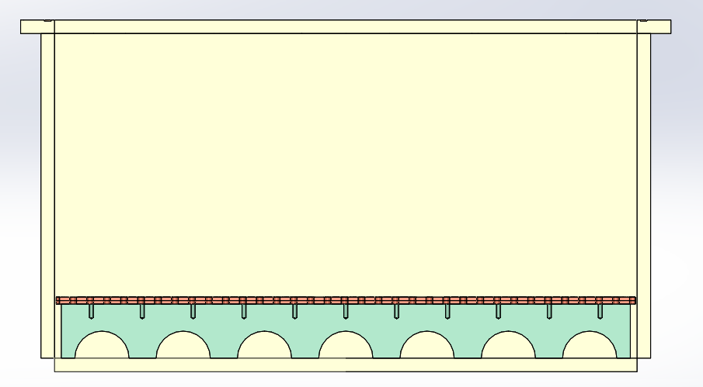
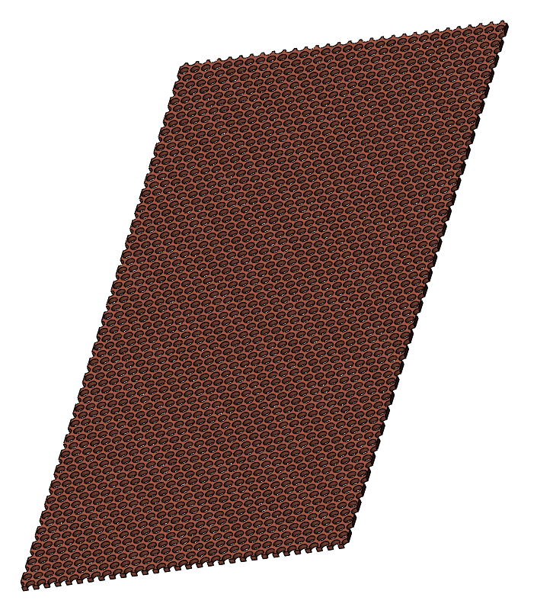
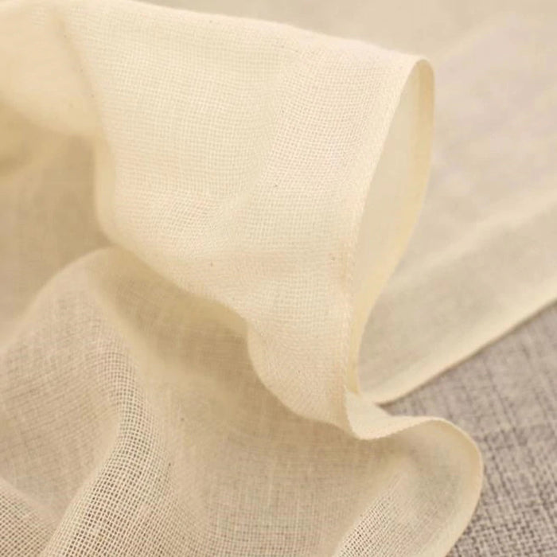
Grate and Cloth
Kevin Hernandez-Lichtl
Perforated Sheet
Fine Cheesecloth to separate Regolith

Slide 20
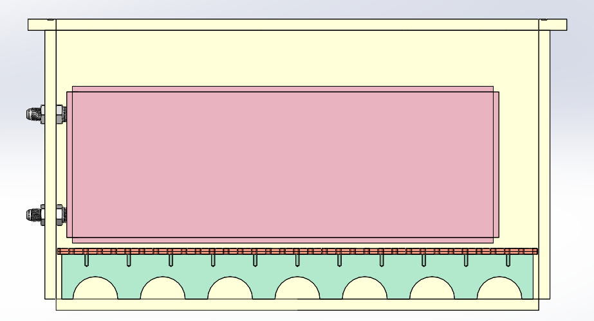
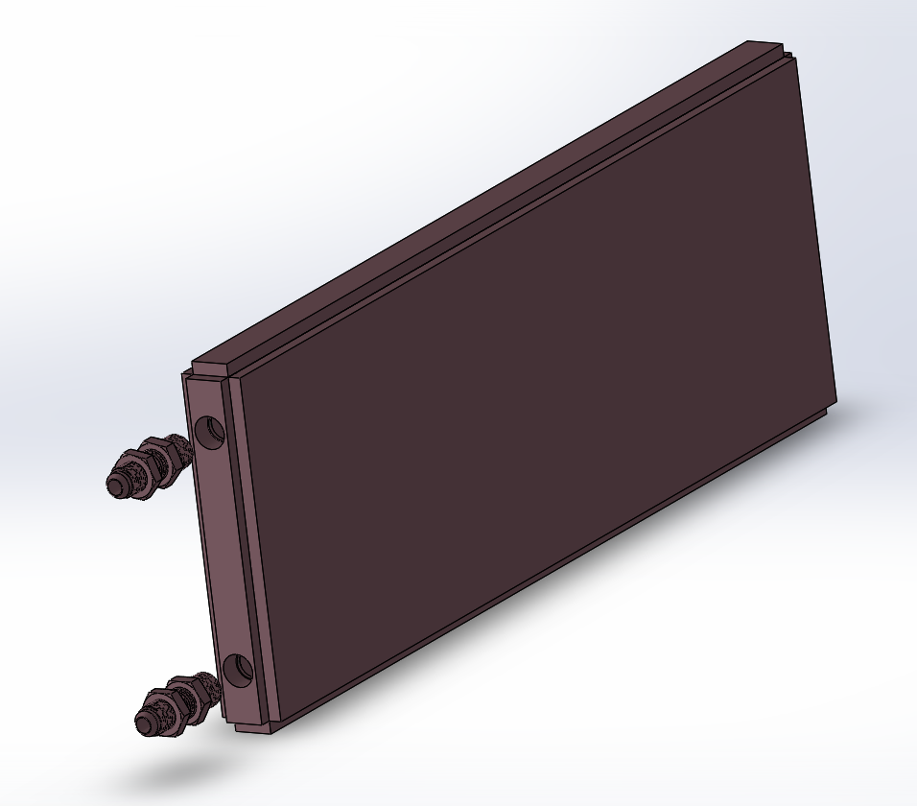
Cooling Sleeves
Kevin Hernandez-Lichtl
Welded Corners and Edges
GN2 Outlet
3/8” Flared Fitting Through Wall Connector
LN2 Inlet

Slide 21
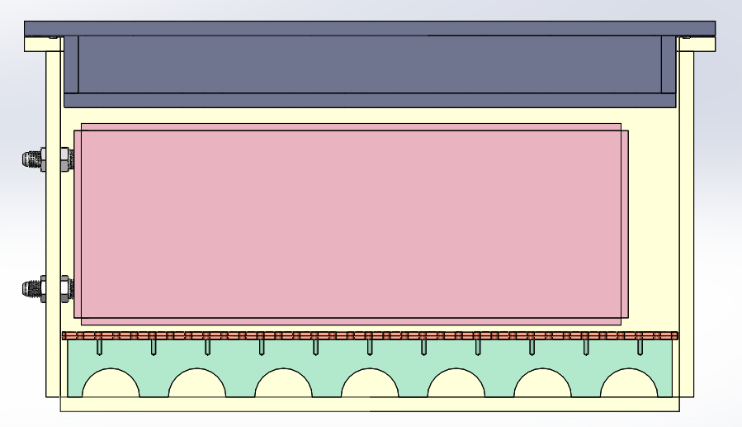
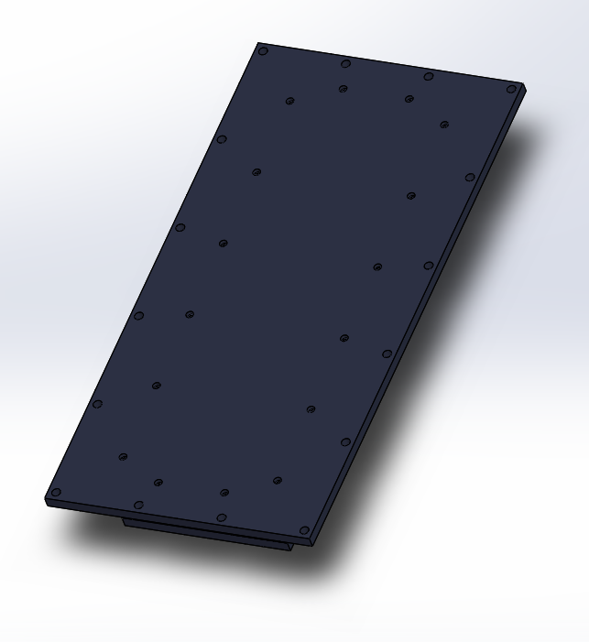
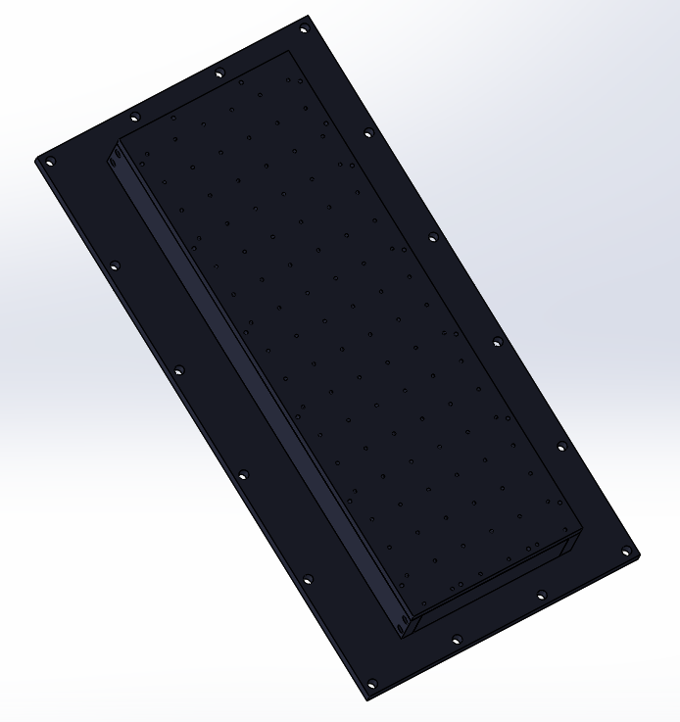
Drip Lid
Kevin Hernandez-Lichtl
Drilled Holes
Flange Bolt Holes
Top View
Bottom View

Slide 22
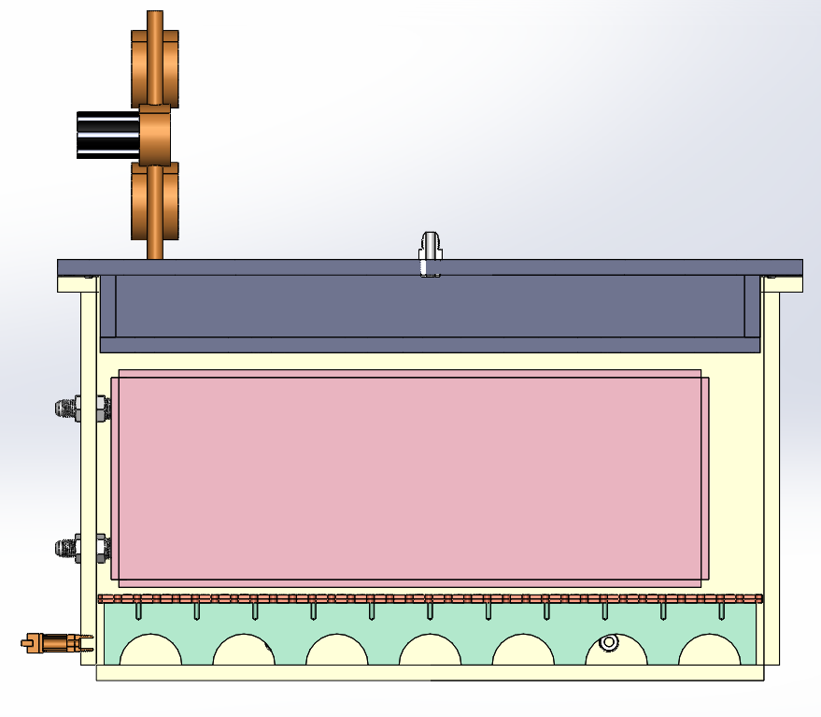
Assembled Section View
Kevin Hernandez-Lichtl

Slide 23
Assembled Section View
Kevin Hernandez-Lichtl

Slide 24
Finite Element Analysis (FEA)
Kevin Hernandez-Lichtl
FEA Results:
25psi Inside Pressure
14.7psi Outside
Minimum FOS of 3.45

Slide 25
Operating Procedure – Pre-Cool
Kevin Hernandez-Lichtl
1
Weigh Out Mass of Regolith

Slide 26
Operating Procedure – Pre-Cool
Kevin Hernandez-Litchl
1
Weigh Out Mass of Regolith
+
2
Calculate Necessary Water Volume
$V_{water}$= $\frac{M_{regolith }× \%_{water}}{1 − \%_{water}}$

Slide 27
Operating Procedure – Pre-Cool
Kevin Hernandez-Lichtl
1
Weigh Out Mass of Regolith
+
=
2
Calculate Necessary Water Volume
THE
HOME DEPOT
3
Mix Regolith and Water

Slide 28
Operating Procedure – Pre-Cool
Kevin Hernandez-Lichtl
1
Weigh Out Mass of Regolith
2
Calculate Necessary Water Volume
3
Mix Regolith and Water
4
Add Sample to Bed

Slide 29
Operating Procedure – Pre-Cool
Kevin Hernandez-Lichtl
Dry Air
1
Weigh Out Mass of Regolith
LN2 Lid
2
Calculate Necessary Water Volume
3
Mix Regolith and Water
4
Add Sample to Bed
5
Purge System with Dry Air

Slide 30
Operating Procedure – Cool Down
Luke Leibkuchler
Sample is ready. Assume at 295K
A
LN2 Cooling Sleeves Prep
Nitrogen Cooling Sleeves
PLANET Chamber
*Not pressurized
PLANET Chamber
*Not pressurized

Slide 31
Operating Procedure – Cool Down
Luke Leibkuchler
Sample is ready. Assume at 295K
A
LN2 Cooling Sleeves Prep
GN2 Exit
Nitrogen Cooling Sleeves
PLANET Chamber
*Not pressurized
PLANET Chamber
*Not pressurized
LN2

Slide 32
Operating Procedure – Cool Down
Luke Leibkuchler
Sample is ready. Assume at 295K
A
LN2 Cooling Sleeves Prep
B
LN2 Sleeves & Drip Lid
GN2 Exit
GN2 Exit
Nitrogen Cooling Sleeves
PLANET Chamber
*Not pressurized
LN2 Cooling Sleeves Still Connected
PLANET Chamber
*Not pressurized
LN2
LN2

Slide 33
Operating Procedure – Post Cool
Luke Leibkuchler
170K-200K Reached
LN2 Cooling Sleeves Still Connected

Slide 34
Operating Procedure – Post Cool
Luke Leibkuchler
170K-200K Reached
1
Remove LN2 Lid
LN2 Cooling Sleeves Still Connected

Slide 35
Operating Procedure – Post Cool
Luke Leibkuchler
170K-200K Reached
1
Remove LN2 Lid
2
Experimental Setup
LN2 Cooling Sleeves Still Connected

Slide 36
Operating Procedure – Post Cool
Luke Leibkuchler
170K-200K Reached
1
Remove LN2 Lid
2
Experimental Setup
3
Ready for Vacuum
LN2 Cooling Sleeves Still Connected

Slide 37
Operating Procedure – Post Cool
Luke Leibkuchler
170K-200K Reached
1
Remove LN2 Lid
2
Experimental Setup
3
Ready for Vacuum
4
LN2 Cooling Sleeves Still Connected
Pump Down

Slide 38
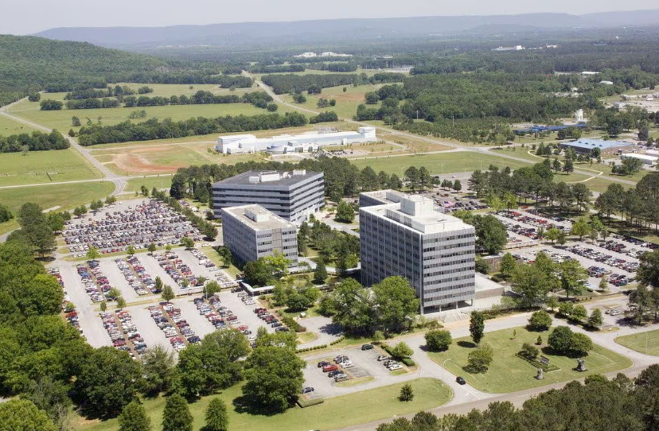
NASA MSFC Testing
Luke Leibkuchler
Confirmed testing procedures and feasibility with team
Travel approved and booked
Testing during Spring Break at NASA MSFC

Slide 39
NASA Preparation: Sensors
Luke Leibkuchler
Thermocouples
Test Fixture
Regolith Sample
Moisture Sensors
Pressure Transducers

Slide 40
NASA Preparation: LabVIEW
Luke Leibkuchler
Temperature Display
Pressure Display
Water Moisture Display

Slide 41
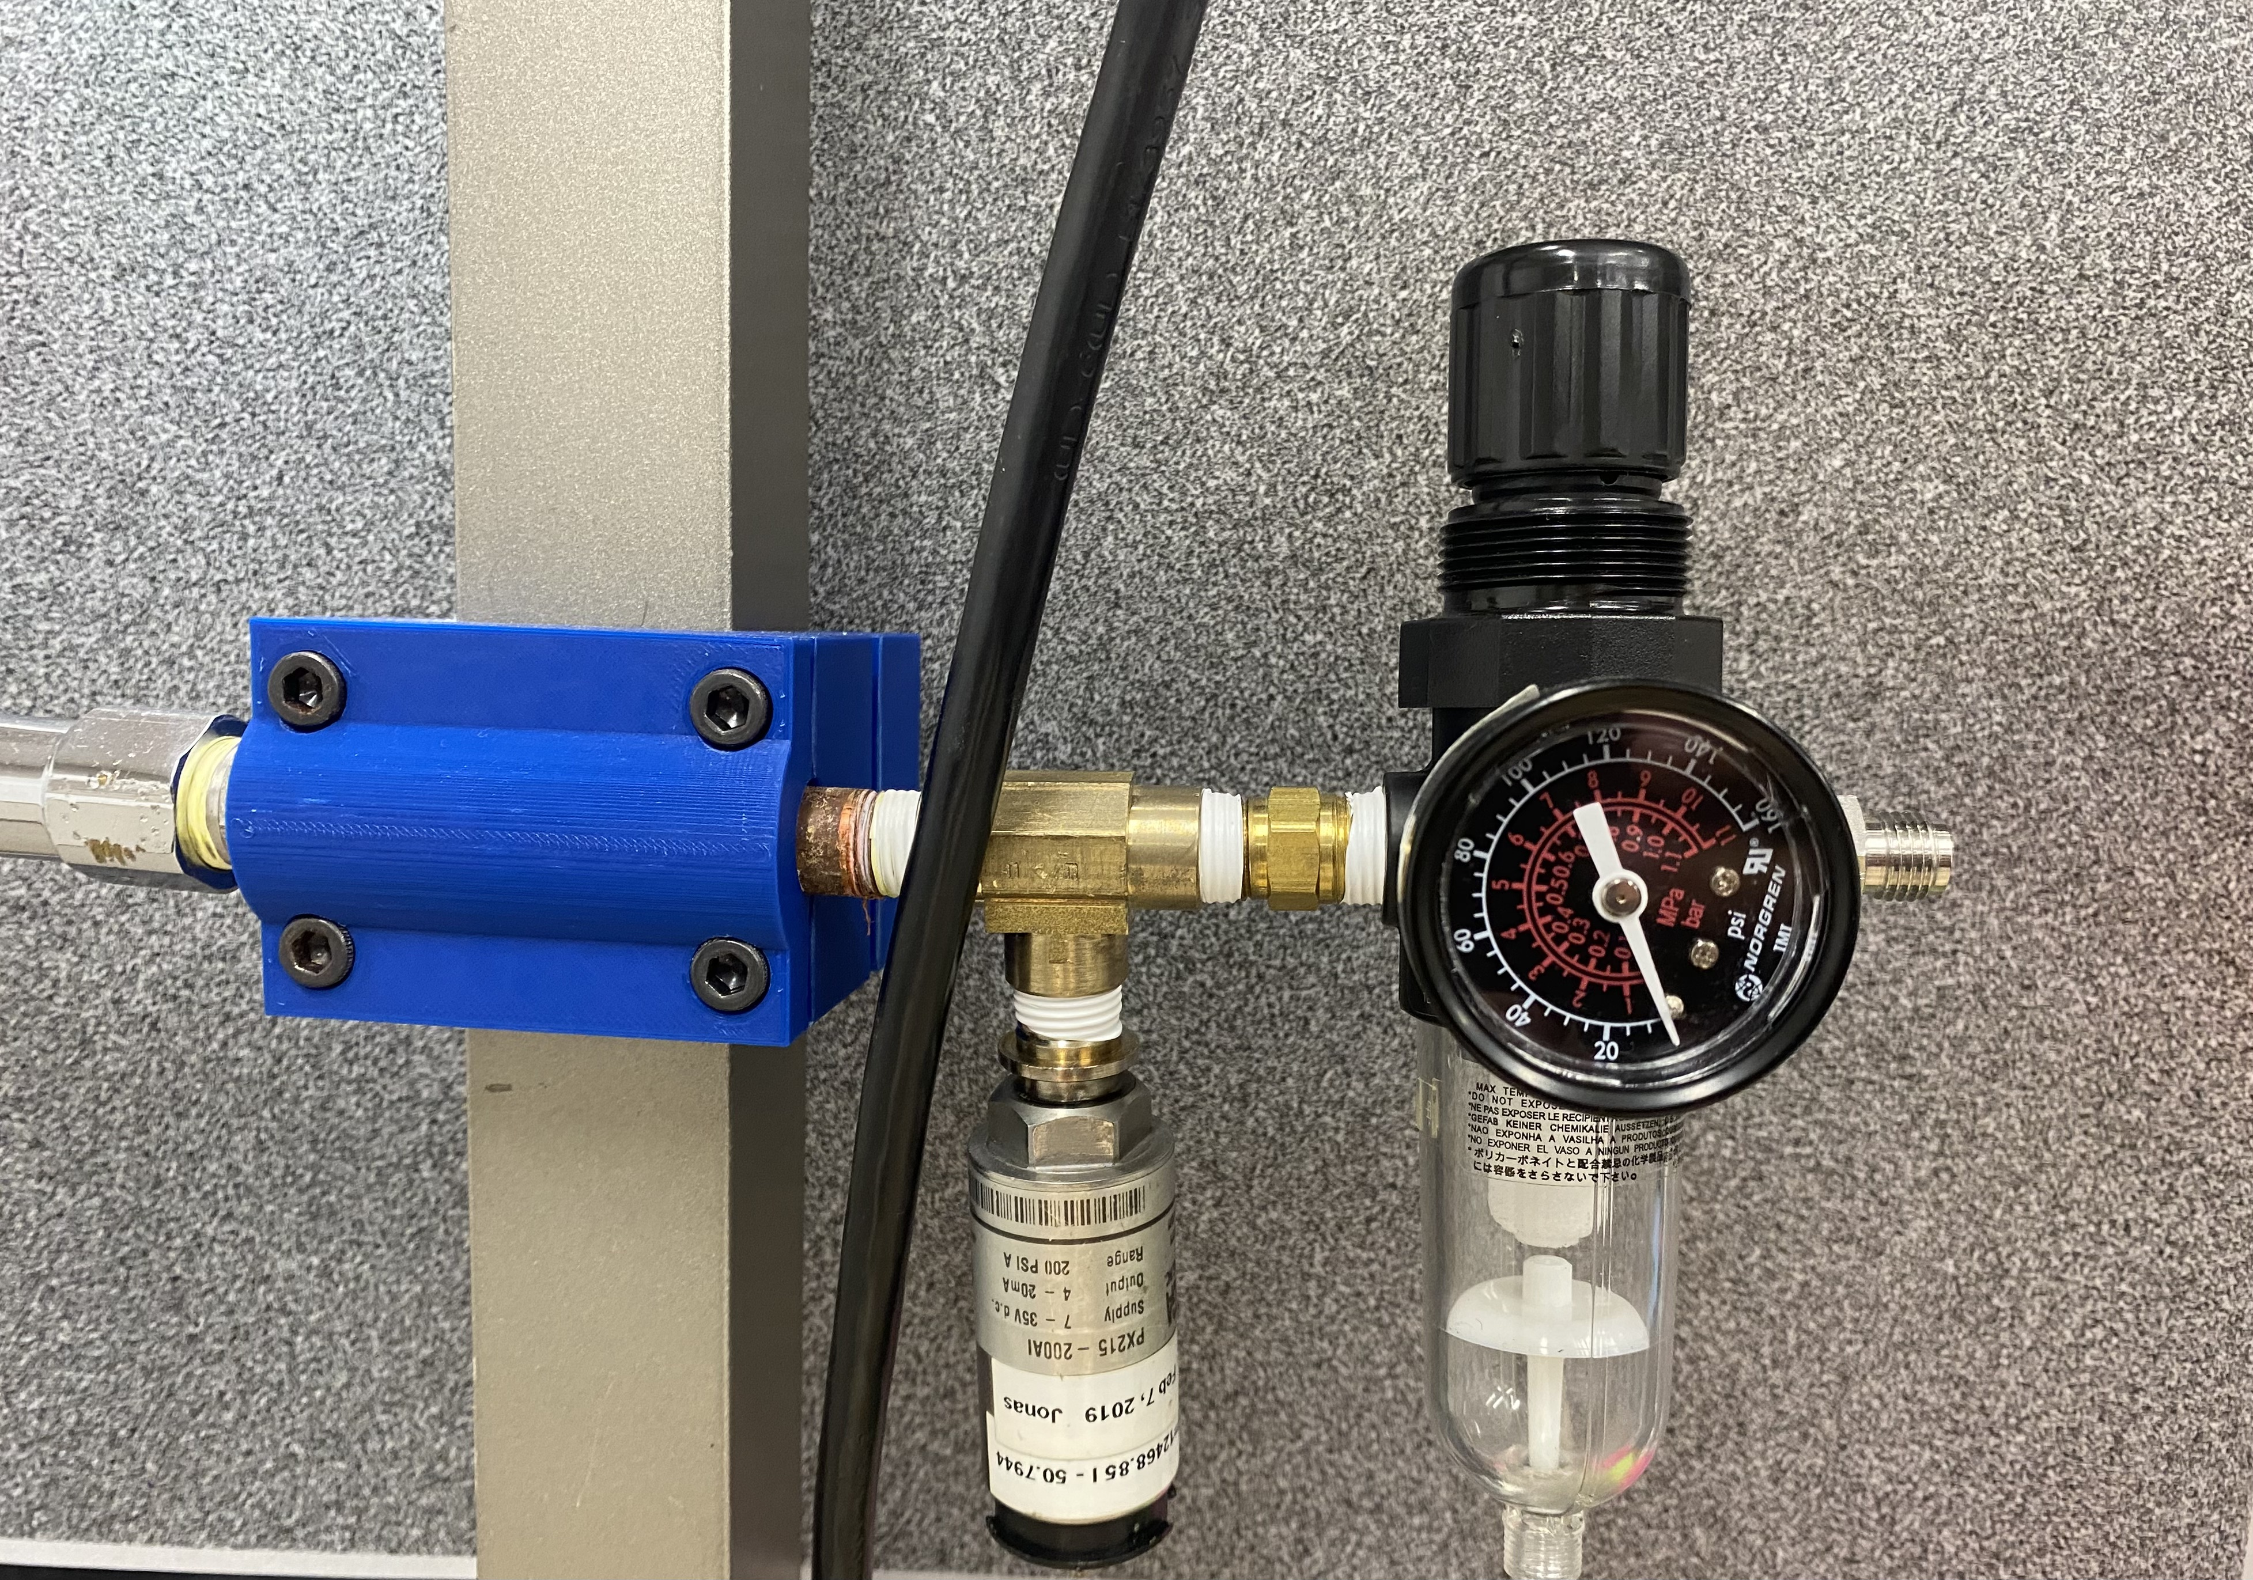
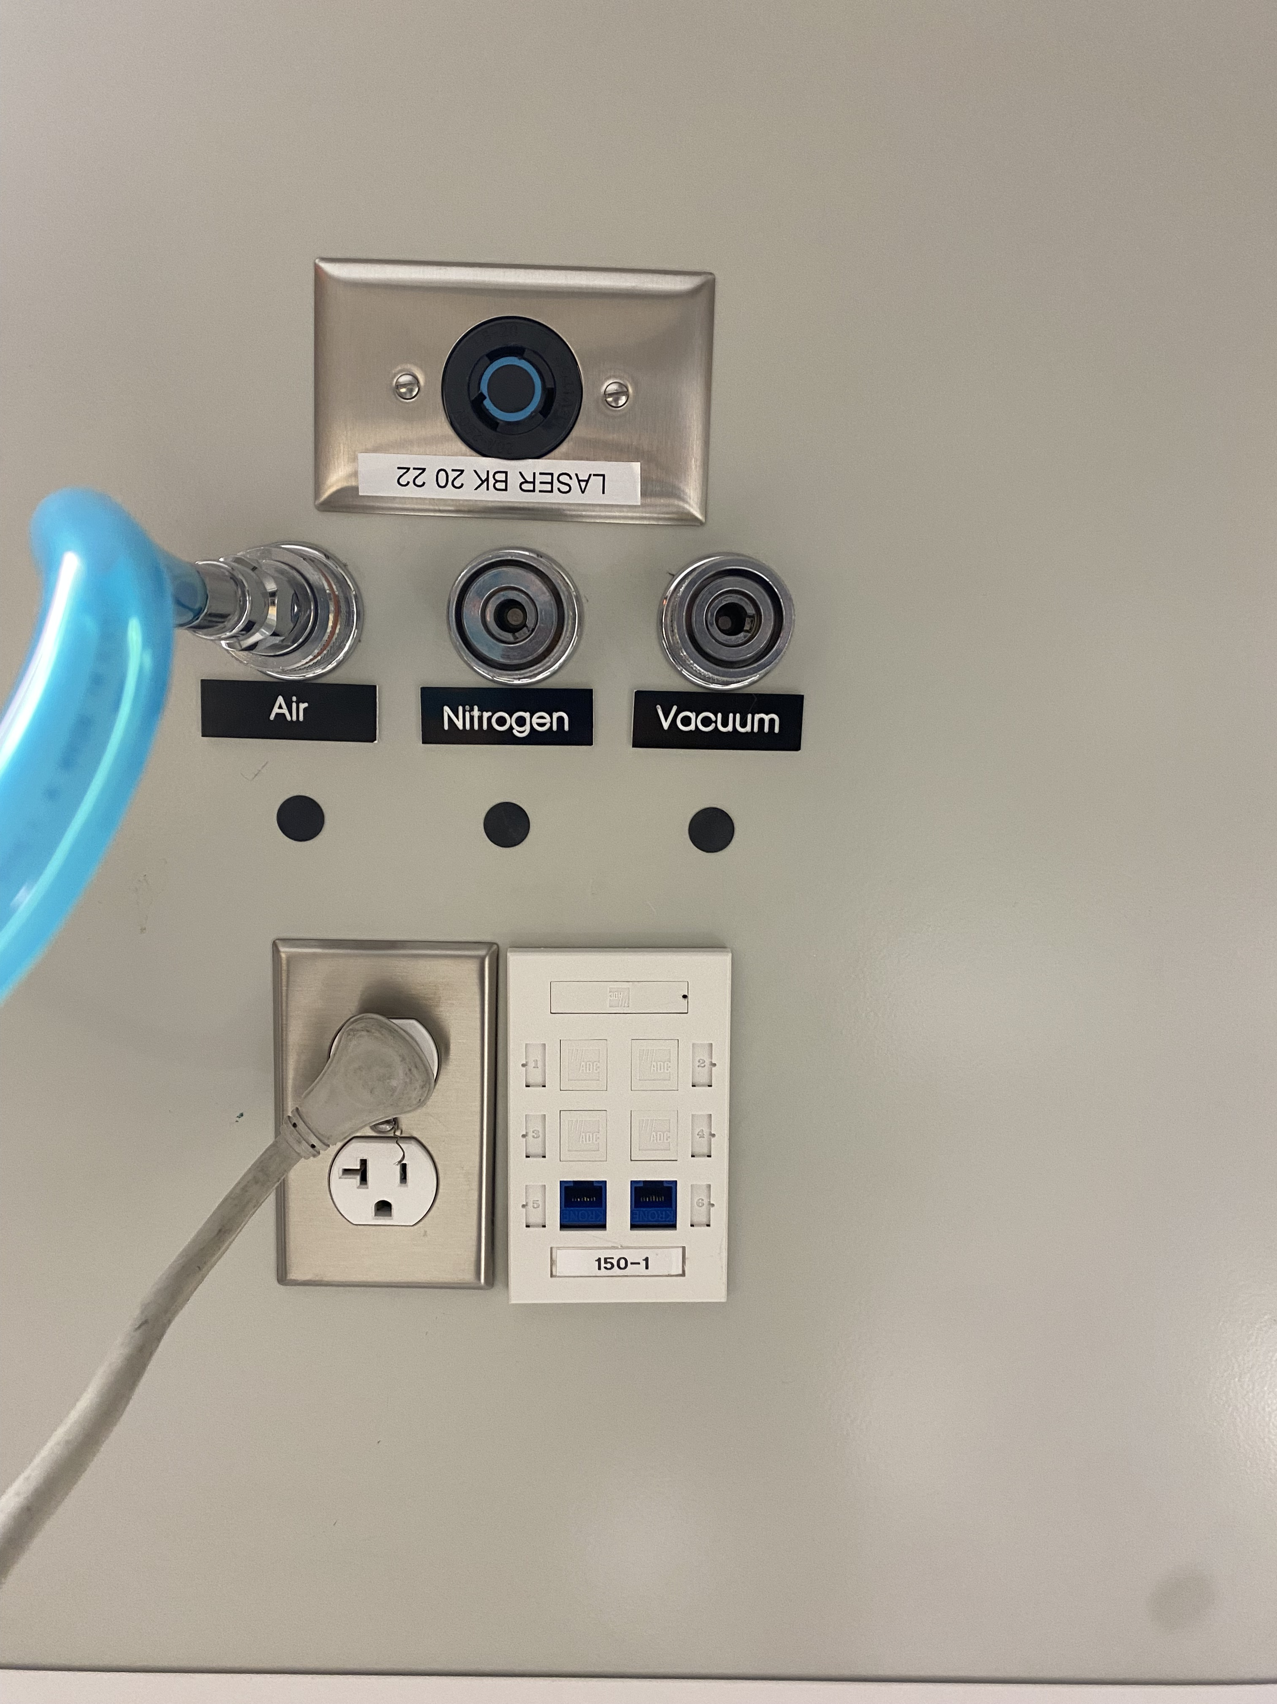
NASA Preparation: Prelim Tests
Luke Leibkuchler
Liquid and Gas testing

Slide 42
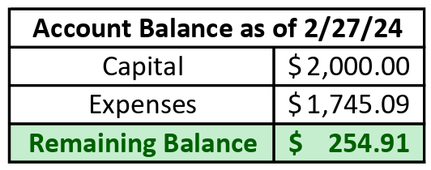
Bill of Materials
Luke Leibkuchler

Slide 43
Contact Information
Luke Leibkuchler
Kevin Hernandez Lichtl
Luke Leibkuchler
Katherine Mesa
Megan Reid
Trent Walker

Slide 44
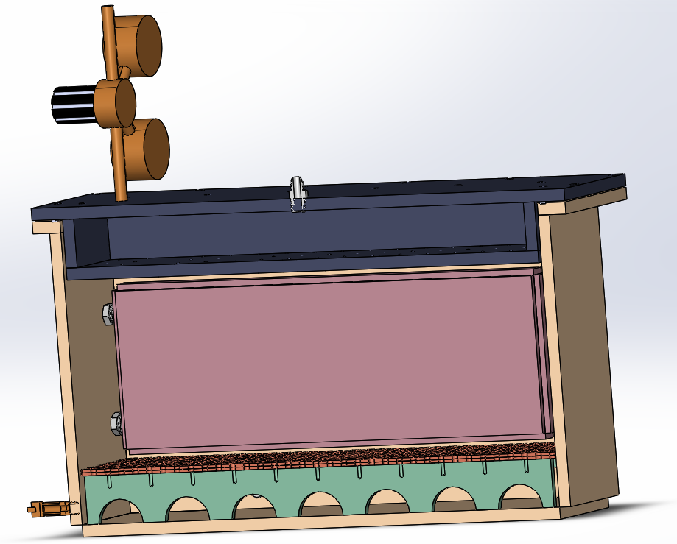
Current Design: Grate
Kevin Hernandez-Litchl

Slide 45
Thank You!
Notes:
Targets and Metrics
Concept Generation and Selection
Prototypes
Biweekly Sponsor Meetings
Risk Assessment
Bill of Materials
Spring Project Plan

Slide 46
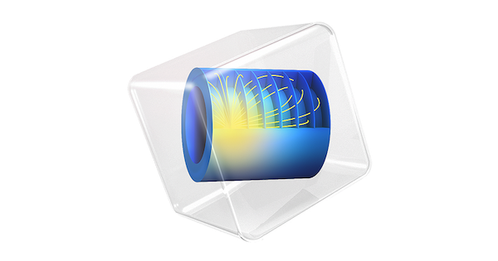
Future Work
Megan Reid
Procurement
Fabrication and Assembly
Programming
Order remaining materials
Begin controls programming and LabView
Continue working on COMSOL model
Run preliminary testing to validate sensors and flow
COMSOL Model
Testing Facility Details
Meet with advising team

Slide 47
NASA MSFC Testing

Slide 48
Pre-Testing Agenda

Slide 49
Customer Needs
Katherine Mesa
1
Control water composition and phase within regolith sample
2
Cool regolith sample to cryogenic temperatures
3
Maintain uniform water composition and phase along with temperature
4
Compatible with PLANET chamber apparatus

Slide 50
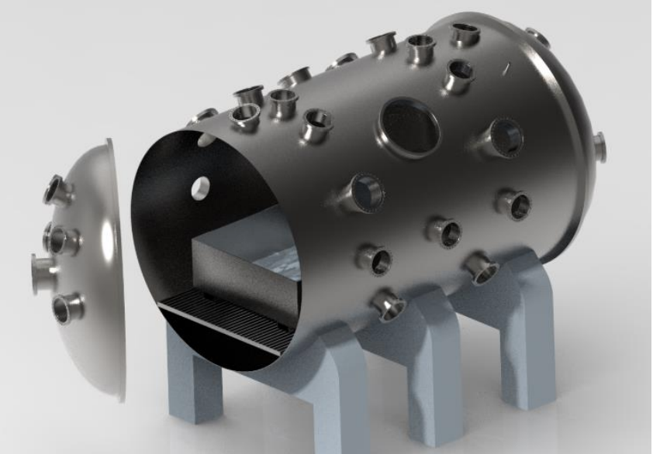
PLANET Chamber
Katherine Mesa
High-fidelity lunar surface environment inside a high-vacuum chamber at NASA
Testing Parameters:
Pressure up to 10⁻⁸ Torr
LN2 plumbing
Notes:
Made of rock chips, mineral fragments, impact and volcanic glasses and a Moon component called “agglutinates”

Slide 51
Functional Decomposition
Katherine Mesa
NASA Cooling Fixture
Thermal
Controls
Structure

Slide 52
Critical Functions
Katherine Mesa
NASA Cooling Fixture
Thermal
Controls
Structure
Pre Pump Down
Post Pump Down
Control water composition
Cool entire mass to cryogenic temperatures
Maintain temperature at high vacuum

Slide 53
Concept Generation
Katherine Mesa
100 Concepts
3 High Fidelity
5 Medium Fidelity

Slide 54
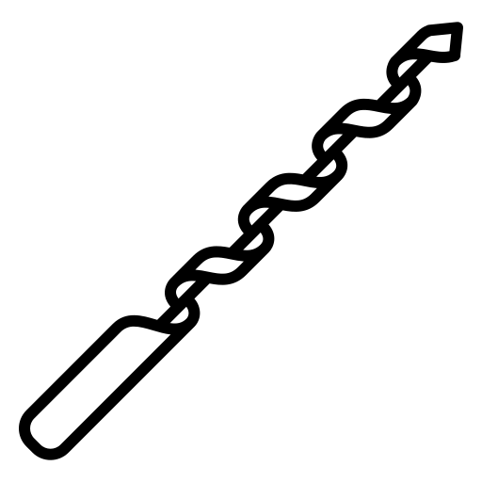
High Fidelity
Katherine Mesa
Cryogenic Jacket
Retractable Augers
1
2
3
Liquid Nitrogen Drip

Slide 55
Properties of Water
Trent Walker
Notes:
Water Phase Diagram
Lots of energy when saying going down to this pressure without sublimating – main reason we are here

Slide 56
Concept Selection Analytical Hierarchy
Katherine Mesa
Notes:
Binary Pairwise, House of Quality, Pugh Chart, AHP

Slide 57
Final Selection
Katherine Mesa
Liquid
Nitrogen Drip
Can Cool Entire Bed Evenly
Ease of Controlling Water Composition
Minimal Impact to PLANET
Operates During Ambient Conditions

Slide 58
Challenges
Megan Reid
1
2
3
4
Cooling
Impermeable layers of ice due to rapid freezing
Temperature reaching the core of the sample

Slide 59
Challenges
Megan Reid
1
2
Liquid Nitrogen
3
4
Cooling
Impermeable layers of ice due to rapid freezing
Temperature reaching the core of the sample
LN2 boil off effects
Expansion rate from LN2 to GN2
Acquiring LN2 for testing

Slide 60
Challenges
Megan Reid
1
2
Liquid Nitrogen
3
Safety Valve
4
Cooling
Impermeable layers of ice due to rapid freezing
Temperature reaching the core of the sample
LN2 boil off effects
Expansion rate from LN2 to GN2
Acquiring LN2 for testing
Optimal location for pressure safety valve

Slide 61
Challenges
Megan Reid
1
2
Liquid Nitrogen
3
Safety Valve
4
Weight
Cooling
Impermeable layers of ice due to rapid freezing
Temperature reaching the core of the sample
LN2 boil off effects
Expansion rate from LN2 to GN2
Acquiring LN2 for testing
Optimal location for pressure safety valve
Ease of transporting
Removing the LN2 lid

Slide 62
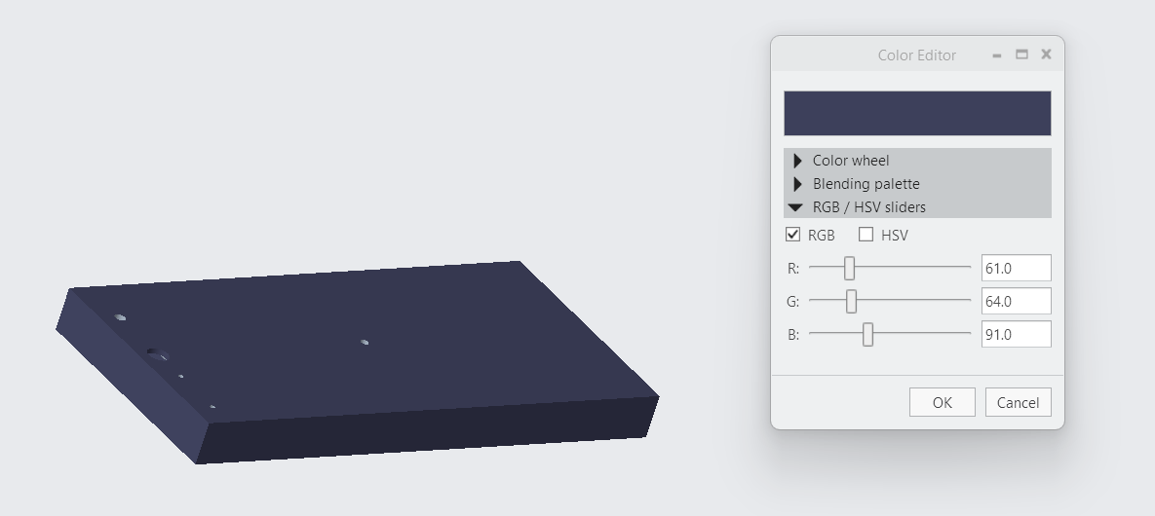
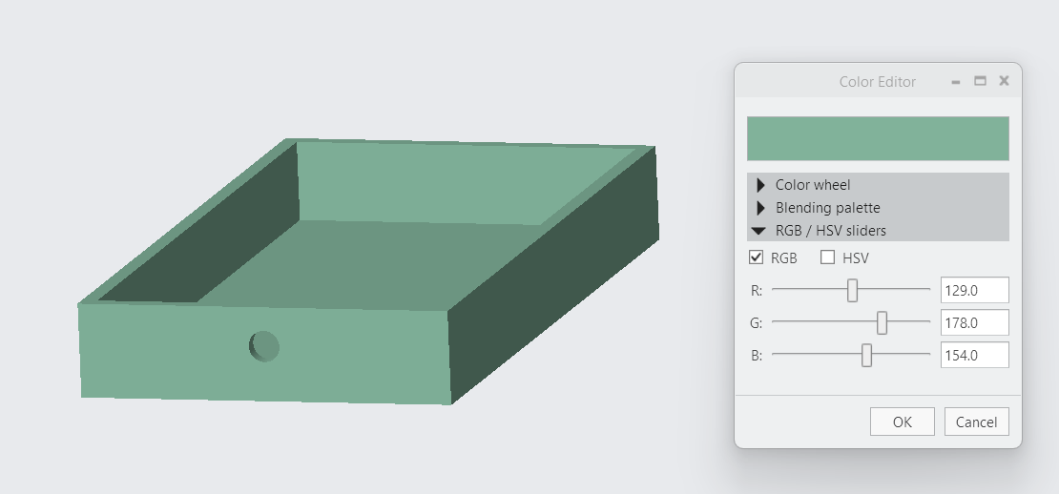
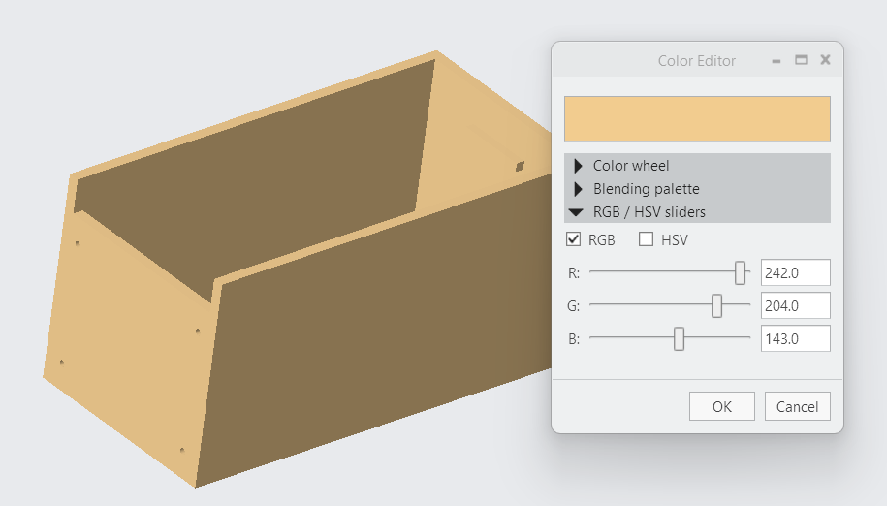
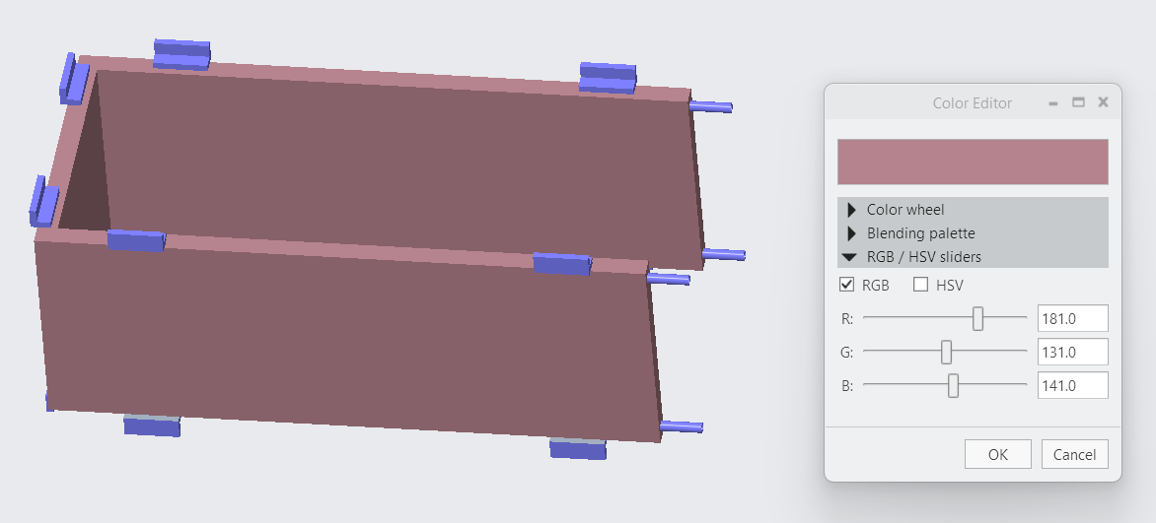

Slide 63
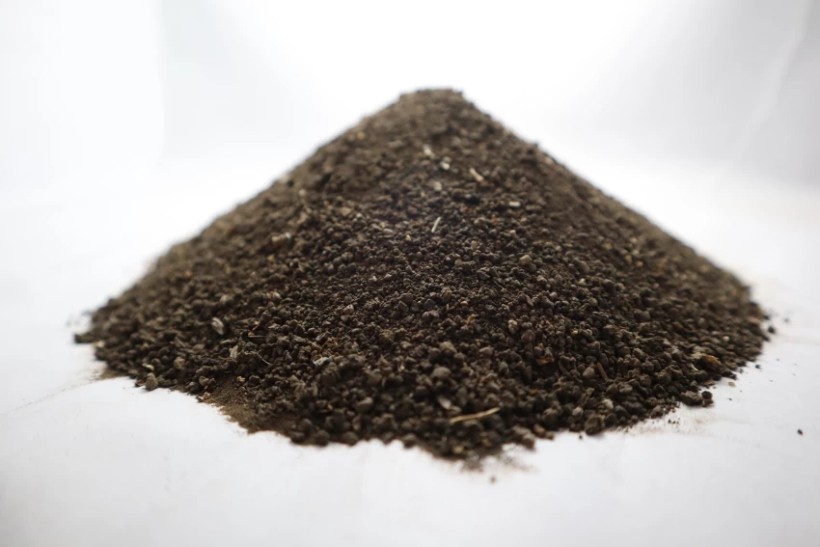
Background
Katherine Mesa
Regolith is the layer of rock and dust on the moon
Highly insulative
Notes:
Made of rock chips, mineral fragments, impact and volcanic glasses and a Moon component called “agglutinates”

Slide 64
Background
Katherine Mesa
Regolith is the layer of rock and dust on the moon
Highly insulative
PLANET Chamber
High-fidelity lunar surface environment inside a high-vacuum chamber at NASA
Notes:
Made of rock chips, mineral fragments, impact and volcanic glasses and a Moon component called “agglutinates”

Slide 65
Customer Needs
Katherine Mesa
1
Control water composition and phase within regolith sample
2
Cool regolith sample to cryogenic temperatures
3
Maintain uniform water composition and phase along with temperature
4
Compatible with PLANET chamber apparatus

Slide 66
Concept Selection
Trent Walker
Binary Pairwise
House of Quality
Pugh Chart
Analytical Hierarchy

Slide 67
Katherine Mesa
Regolith Fixture
Notes:
Made of rock chips, mineral fragments, impact and volcanic glasses and a Moon component called “agglutinates”

Slide 68
Katherine Mesa
Regolith Fixture
Notes:
Made of rock chips, mineral fragments, impact and volcanic glasses and a Moon component called “agglutinates”

Slide 69
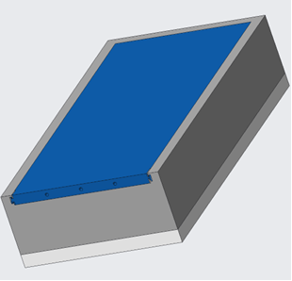
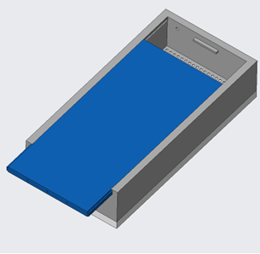
Preliminary Drip Lid CAD
Kevin Hernandez Lichtl
Top View - Closed
Top View - Open

Slide 70
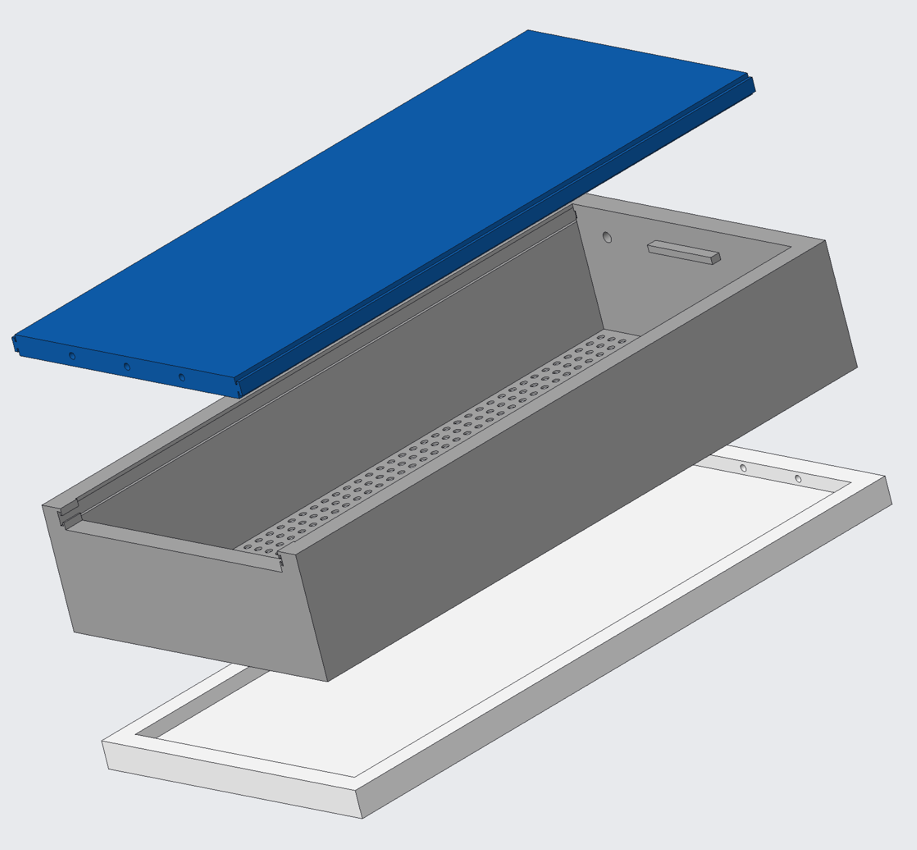
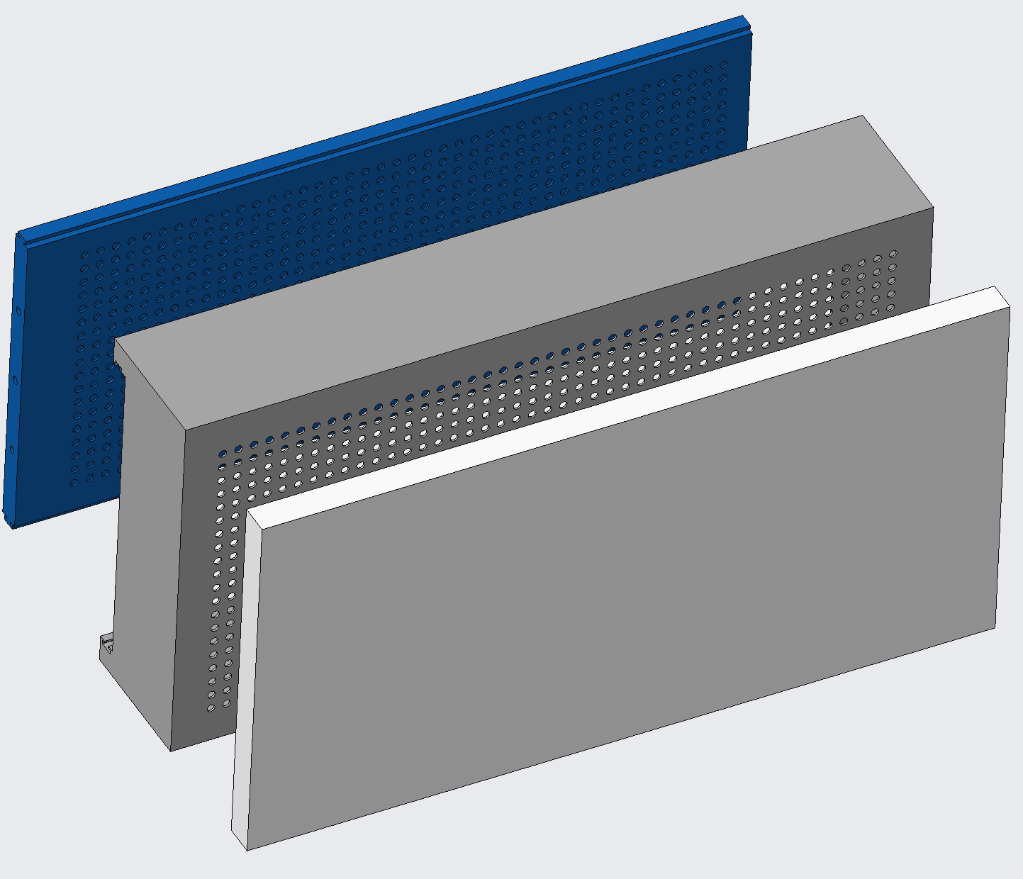
Preliminary Drip Lid CAD
Kevin Hernandez Lichtl
Side View - Exploded
Bottom View - Exploded

Slide 71
Current Design: Assembly
Megan Reid

Slide 72
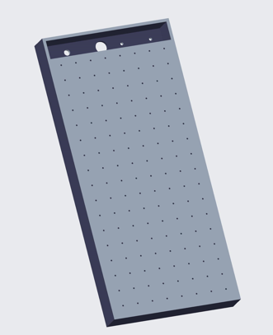
Current Design: Lid
Megan Reid
LN2 Inlet
Top View
Bottom View

Slide 73
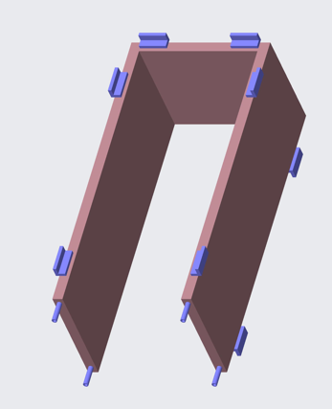
Current Design: Jacket
Megan Reid

Slide 74
Current Design: Grate
Megan Reid

Slide 75
Current Design: Bottom
Megan Reid
Notes:
Sample is mixed and you’re ready to cool it down.

Slide 76
Katherine Mesa
Our Job
Simulate lunar surface conditions with a regolith simulant
Cryogenic Temperature
Water Composition and Phase
Compatible with PLANET chamber
Notes:
Made of rock chips, mineral fragments, impact and volcanic glasses and a Moon component called “agglutinates”

Slide 77
Liquid Nitrogen Drip
Kevin Hernandez Lichtl
LN2 Liquid
LN2 Liquid Drip
Regolith Bed
1
2
3

Slide 78
Liquid Nitrogen Drip
Kevin Hernandez Lichtl
LN2 Liquid
LN2 Liquid Drip
LN2 Gas Exit
Pump
Regolith Bed
1
2
3

Slide 79
Liquid Nitrogen Drip
Kevin Hernandez Lichtl
LN2 Liquid
LN2 Liquid Drip
LN2 Gas Exit
Pump
Regolith Bed
Bottom Grate
LN2 Gas Reentry
1
2
3

Slide 80
Liquid Nitrogen Drip
Kevin Hernandez Lichtl
LN2 Liquid
LN2 Liquid Drip
LN2 Gas Exit
Pump
Regolith Bed
LN2 Gas Exit
Bottom Grate
LN2 Gas Reentry
1
2
3

Slide 81
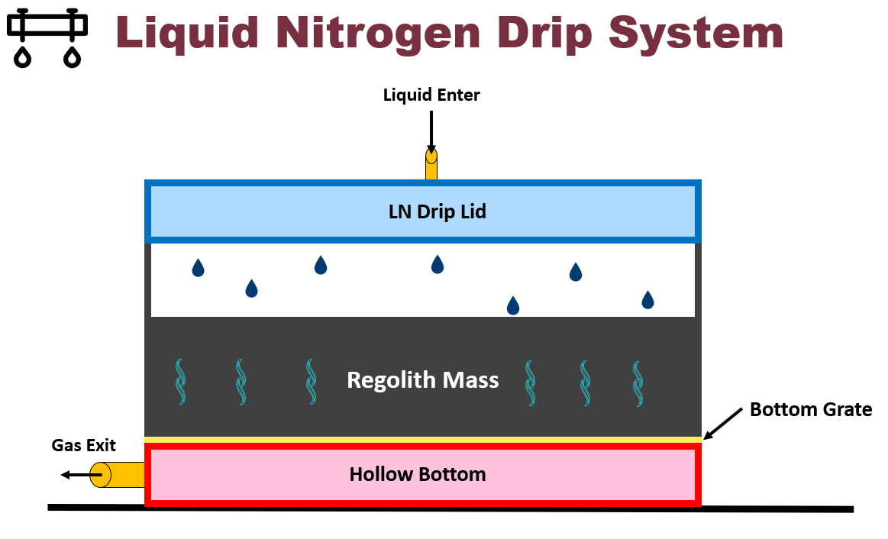
Kevin Hernandez Lichtl

Slide 82
Operating Procedure – Post Cool
Megan Reid
170K-200K Reached
1
Remove N2 Lid
2.5
Add Styrofoam Lid
LN2 Jacket Still Connected

Slide 83
PLANET Chamber Planetary, Lunar, and Asteroid Natural Environments Testbed
Megan Reid
A high-fidelity lunar surface environment inside a well equipped high-vacuum chamber at NASA’s Marshall Space Flight Center

Slide 84
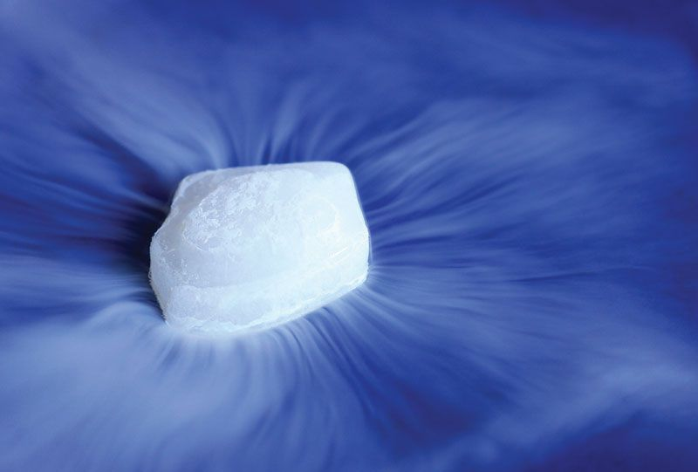
Current Issue
Megan Reid
Water ice in regolith will sublimate to gas if not cold enough before high vacuum
Water vapor condenses out of air when cooled before vacuum
Notes:
Water VAPOR, condenses out of air when cooled before vacuum...
affecting regolith-water content

Slide 85
Megan Reid
Key Goals
Thermal Maintenance
Regolith
PLANET
Chamber
High Vacuum
Notes:
Cool regolith simulant bed before and during high vacuum (10^-7 Torr)
Regolith needs to be cooled to a low enough temperature before depressurization so that water ice doesn’t sublimate
Needs to fit within the NASA PLANET Chamber

Slide 86
Properties of Water
Megan Reid

Slide 87
Customer Needs
Katherine Mesa
Water
Phase
Uniform
Properties
Monitor
Properties
PLANET
Chamber
Pressure
Maintain water in the solid phase
Water will be in the regolith

Slide 88
Customer Needs
Katherine Mesa
Water
Phase
Uniform
Properties
Monitor
Properties
PLANET
Chamber
Pressure
Maintain water in the solid phase
Water will be in the regolith
Operates in atmospheric to high vacuum pressure
Mimics space environment

Slide 89
Customer Needs
Katherine Mesa
Water
Phase
Uniform
Properties
Monitor
Properties
PLANET
Chamber
Pressure
Maintain water in the solid phase
Water will be in the regolith
Operates in atmospheric to high vacuum pressure
Mimics space environment
Reaches desired moisture, pressure, and temperature in regolith

Slide 90
Customer Needs
Katherine Mesa
Water
Phase
Uniform
Properties
Monitor
Properties
PLANET
Chamber
Pressure
Maintain water in the solid phase
Water will be in the regolith
Operates in atmospheric to high vacuum pressure
Mimics space environment
Reaches desired moisture, pressure, and temperature in regolith
Ability to monitor moisture, pressure, and temperature in regolith

Slide 91
Customer Needs
Katherine Mesa
Water
Phase
Uniform
Properties
Monitor
Properties
PLANET
Chamber
Pressure
Maintain water in the solid phase
Water will be in the regolith
Operates in atmospheric to high vacuum pressure
Mimics space environment
Reaches desired moisture, pressure, and temperature in regolith
Ability to monitor moisture, pressure, and temperature in regolith
Fits into and is compatible with the PLANET Chamber

Slide 92
Customer Needs
Luke Leibkuchler
Maintain Water at Ice in Regolith
Operate in Atmospheric to High Vacuum Pressure
Uniform Moisture, Pressure, and Temperature in Regolith
Ability to Monitor Properties
Operate in PLANET Chamber

Slide 93
Customer Needs
Luke Leibkuchler
Maintain Water at Ice in Regolith
Operate in Atmospheric to High Vacuum Pressure
Uniform Moisture, Pressure, and Temperature in Regolith
Ability to Monitor Properties
Operate in PLANET Chamber

Slide 94
Customer Needs
Luke Leibkuchler
Maintain Water at Ice in Regolith
Operate in Atmospheric to High Vacuum Pressure
Uniform Moisture, Pressure, and Temperature in Regolith
Ability to Monitor Properties
Operate in PLANET Chamber

Slide 95
Customer Needs
Luke Leibkuchler
Maintain Water at Ice in Regolith
Operate in Atmospheric to High Vacuum Pressure
Uniform Moisture, Pressure, and Temperature in Regolith
Ability to Monitor Properties
Operate in PLANET Chamber

Slide 96
Customer Needs
Luke Leibkuchler
Maintain Water at Ice in Regolith
Operate in Atmospheric to High Vacuum Pressure
Uniform Moisture, Pressure, and Temperature in Regolith
Ability to Monitor Properties
Operate in PLANET Chamber

Slide 97
Customer Needs
Luke Leibkuchler
Maintain Water at Ice in Regolith
Operate in Atmospheric to High Vacuum Pressure
Uniform Moisture, Pressure, and Temperature in Regolith
Ability to Monitor Properties
Operate in PLANET Chamber

Slide 98
Customer Needs
Maintain Water at Ice
Operate in Atmospheric to High Vacuum Pressure
Uniform Moisture, Pressure, and Temperature in Regolith
Ability to Monitor Properties
Operate in PLANET Chamber

Slide 99
Functional Decomposition
Luke Leibkuchler
NASA Regolith Cooling Fixture
Thermal
Structure
Controls

Slide 100
Functional Decomposition
Luke Leibkuchler
NASA Regolith Cooling Fixture
Thermal
Structure
Controls

Slide 101
Functional Decomposition
Luke Leibkuchler
Thermal
Pre Pump Down
Post Pump Down
Water in Air
Cool Entire Mass to Cryogenic Temperatures
High Vacuum

Slide 102
Functional Decomposition
Luke Leibkuchler
NASA Regolith Cooling Fixture
Thermal
Structure
Controls

Slide 103
Functional Decomposition
Luke Leibkuchler
Controls
User Interface
Motion
Data Acquisition
Display
Hatch

Slide 104
Functional Decomposition
Luke Leibkuchler
NASA Regolith Cooling Fixture
Thermal
Structure
Controls

Slide 105
Functional Decomposition
Luke Leibkuchler
Structure
Operate within PLANET
Withstand PLANET
In and Out of Chamber
Within Dimensions
Electrical Components
Integrity at Extreme Conditions

Slide 106
Functional Decomposition
Thermal
Pre-Pump Down
Post-Pump Down
Prevent water condensation
Cool entire regolith mass to –180 degC
Maintain high vacuum pressure within the fixture
Maintain specific regolith-water composition

Slide 107
Functional Decomposition
Structure
Operate within PLANET chamber
Withstand PLANET conditions
Protect electrical/
mechanical components
Maintain structural integrity
Allows transport in and out of chamber
Fit within chamber dimensions
Withstands cryogenic temperatures
Withstands high vacuum
Utilizes materials invisible to microwave radiation
Allows flow of coolant

Slide 108
Functional Decomposition
Controls
Motion
User Interface
DAQ
Display
Open hatch for testing
Close hatch after testing
Collect water moisture and fixture pressure data
Collect
temperature data
Display water moisture and fixture pressure data
Display hatch position data
Collect hatch position data
Collect coolant flow rate data
Display temperature data
Display coolant flow rate data

Slide 109
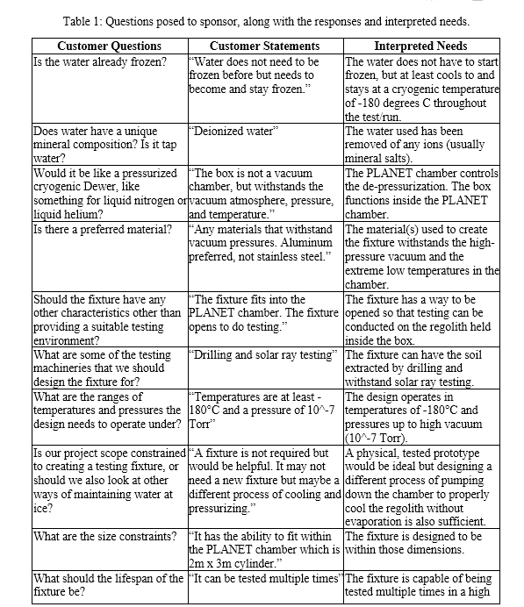
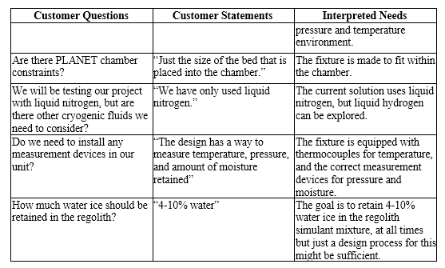
Customer Needs

Slide 110
Megan Reid
Key Goals
Thermal Maintenance
Notes:
Cool regolith simulant bed before and during high vacuum (10^-7 Torr)
Regolith needs to be cooled to a low enough temperature before depressurization so that water ice doesn’t sublimate
Needs to fit within the NASA PLANET Chamber

Slide 111
Megan Reid
Key Goals
Thermal Maintenance
Regolith
Notes:
Cool regolith simulant bed before and during high vacuum (10^-7 Torr)
Regolith needs to be cooled to a low enough temperature before depressurization so that water ice doesn’t sublimate
Needs to fit within the NASA PLANET Chamber

Slide 112
Megan Reid
Key Goals
Thermal Maintenance
Regolith
PLANET
Chamber
Notes:
Cool regolith simulant bed before and during high vacuum (10^-7 Torr)
Regolith needs to be cooled to a low enough temperature before depressurization so that water ice doesn’t sublimate
Needs to fit within the NASA PLANET Chamber

Slide 113
Megan Reid
Key Goals
Thermal Maintenance
Regolith
PLANET
Chamber
High Vacuum
Notes:
Cool regolith simulant bed before and during high vacuum (10^-7 Torr)
Regolith needs to be cooled to a low enough temperature before depressurization so that water ice doesn’t sublimate
Needs to fit within the NASA PLANET Chamber

Slide 114
Megan Reid
Assumptions
Materials provided for final testing at NASA - MSFC
Operating Conditions
PLANET Chamber
Humidity is controlled at 65%
Instrumentation
Cooling with Cryogenic Liquids
Regolith Simulant
No extreme conditions
Notes:
Following Materials will supplied:
Liquid Nitrogen
Regolith Simulant
Vacuum Chamber
Instrumentation
Final testing conducted at Marshall Space Flight Center
Humidity is at 65% (controlled)

Slide 115
Markets & Stakeholders
Megan Reid
NASA - MSFC
SpaceX
Boeing
Blue Origin
Other Private Aerospace Companies
Notes:
Primary:
NASA
Secondary:
SpaceX, Boeing, or Blue Origin
Private aerospace companies developing extraction and excavation technologies

Slide 116
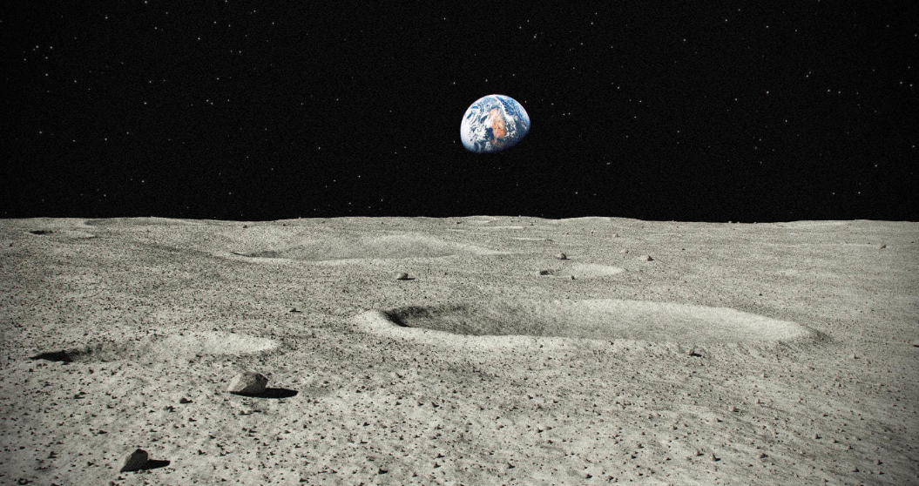
Targets and Metrics
Trent Walker
4-10%
1.33e-4 Pa – 1.33e-5 Pa
173.15 K - 203.15 K
Notes:
Units are trash

Slide 117
Customer Needs
Luke Leibkuchler
Water
Phase
Uniform
Properties
Monitor
Properties
PLANET
Chamber
Pressure
Maintain water in the solid phase
Water will be in the regolith

Slide 118
Customer Needs
Luke Leibkuchler
Water
Phase
Uniform
Properties
Monitor
Properties
PLANET
Chamber
Pressure
Maintain water in the solid phase
Water will be in the regolith
Operates in atmospheric to high vacuum pressure
Mimics space environment

Slide 119
Customer Needs
Luke Leibkuchler
Water
Phase
Uniform
Properties
Monitor
Properties
PLANET
Chamber
Pressure
Maintain water in the solid phase
Water will be in the regolith
Operates in atmospheric to high vacuum pressure
Mimics space environment
Reaches desired moisture, pressure, and temperature in regolith

Slide 120
Customer Needs
Luke Leibkuchler
Water
Phase
Uniform
Properties
Monitor
Properties
PLANET
Chamber
Pressure
Maintain water in the solid phase
Water will be in the regolith
Operates in atmospheric to high vacuum pressure
Mimics space environment
Reaches desired moisture, pressure, and temperature in regolith
Ability to monitor moisture, pressure, and temperature in regolith

Slide 121
Customer Needs
Luke Leibkuchler
Water
Phase
Uniform
Properties
Monitor
Properties
PLANET
Chamber
Pressure
Maintain water in the solid phase
Water will be in the regolith
Operates in atmospheric to high vacuum pressure
Mimics space environment
Reaches desired moisture, pressure, and temperature in regolith
Ability to monitor moisture, pressure, and temperature in regolith
Fits into and is compatible with the PLANET Chamber

Slide 122
Future Work
Luke Leibkuchler
Target &
Metrics
Prototypes
Risk
Assessment
Create prototypes of high-fidelity concepts to aid in selection
Set targets and metrics for system
Perform risk assessment
Generate 100 ideas for solution that fits needs and targets
Select final concept
Create bill of materials
Concept
Generation
Concept
Selection
Bill of
Materials
Meet with advising team
Notes:
Targets and Metrics
Concept Generation and Selection
Prototypes
Biweekly Sponsor Meetings
Risk Assessment
Bill of Materials
Spring Project Plan

Slide 123
Preliminary Drip Lid CAD
Top View - Closed
Top View - Open

Slide 124
Preliminary Drip Lid CAD
Side View - Exploded
Bottom View - Exploded

Slide 125
Thank You!
Notes:
Targets and Metrics
Concept Generation and Selection
Prototypes
Biweekly Sponsor Meetings
Risk Assessment
Bill of Materials
Spring Project Plan

Slide 126
This is 10-point
This is 15–point Times
This is 20–point
This is 25–point
This is 30–point
This is 35–point
This is 40–point
This is 50–point
This is 60–point
This is 72–point
Notes:
Use at least 20-point font in Room A105, B134, and B136
Use at least 25-point font in Room B135

Slide 127
College of Engineering Color Palette
1 2 3 4
Pantone: PMS 195 C
RGB: 120, 47, 64
Hex: #782F40
CMYK:19, 90, 50, 55
1 2 3 4
Pantone: Black C
RGB: 0, 0, 0
Hex: #000000
CMYK:0, 0, 0, 100
Garnet
Black
1 2 3 4
RGB: 238, 118, 36
Hex: #EE7624
CMYK:2, 66, 99, 0
1 2 3 4
Pantone: PMS 000C
RGB: 255, 255, 255
Hex: #FFFFFF
CMYK: 0, 0, 0, 0
Fang
Orange
White
Notes:
Avoid 75% Black in B135

Slide 128
Accent Color Palette
1 2 3 4
RGB: 0, 59, 111
Hex: #003B6F
CMYK:
1 2 3 4
RGB: 0, 59, 111
Hex: #003B6F
CMYK:
1 2 3 4
RGB: 251, 236, 93
Hex: #FBEC5D
CMYK:
1 2 3 4
RGB: 219, 215, 210
Hex: #DBD7D2
CMYK:
1 2 3 4
RGB: 251, 236, 93
Hex: #FBEC5D
CMYK:
1 2 3 4
RGB: 219, 215, 210
Hex: #DBD7D2
CMYK:
Tardis Blue
Tardis Blue
Corn
Timberwolf
Corn
Timberwolf
1 2 3 4
RGB: 206, 0, 88
Hex: #CE0058
CMYK: 0, 100, 43, 12
1 2 3 4
RGB: 206, 0, 88
Hex: #CE0058
CMYK: 0, 100, 43, 12
1 2 3 4
RGB: 104, 40, 96
Hex: #682860
CMYK:
1 2 3 4
RGB: 220, 220, 220
Hex: #DCDCDC
CMYK:
Rubine Red
Rubine Red
Imperial
Gainsboro
1 2 3 4
RGB: 72, 146, 155
Hex: #48929b
CMYK:
1 2 3 4
RGB: 64, 224, 208
Hex: #40E0D0
CMYK:
1 2 3 4
RGB: 255, 139, 0
Hex: #FF8B00
CMYK:
Asagi-iro
Turquoise
American Orange
Notes:
Remove American orange add hyperlink grey
Make corn the last for b135
All work in 134 imperial move later
Tardis doesn’t work in b136

Slide 129
F7AB19
D67F15
EE7624
D64615
F73119
Analogous
https://color.adobe.com/create/color-wheel
6E3610
F0A16C
EE7624
6E4931
BASB1C
Monochromatic
A14508
4BED3B
EE7624
250CED
2010A1
Triad
A1470C
FF8C40
EE7624
0098A1
24E2ED
Complementary
28A164
2FED8D
EE7624
0848A1
1871ED
Split Complementary
EDAC2F
3BED93
EE7624
0C6AED
ED2F18
Double Split Complementary
ED660C
C7ED3B
EE7624
0CE1ED
A418ED
Square
BA7E09
87724A
EE7624
60EFCF
09BA61
Compound
AD551A
6E3610
EE7624
FA7625
D46820
Shades
Notes:
These are the variants that work well with Fang Orange. The bolded items show well on the projectors.

Slide 130
85412D
8F3831
782f40
8F3176
792D85
Analogous
https://color.adobe.com/create/color-wheel
C44D69
8E626D
782F40
C48796
451B25
Monochromatic
C43959
78743B
782F40
236178
43A2C4
Triad
C43959
C46078
782F40
25C43D
2F783A
Complementary
93C460
577835
782F40
39C49D
297861
Split Complementary
784435
5A783B
782F40
237860
6E2978
Double Split Complementary
782337
78683b
782F40
237830
293978
Square
AB4D32
DEBAAF
782F40
5D8555
70AB32
Compound
38161E
C44D69
782F40
853447
5E2532
Shades

Slide 131
A105
A105
B135 Stage Left
B135 Stage Right
B136
B134, A105
B135

